Slide 1
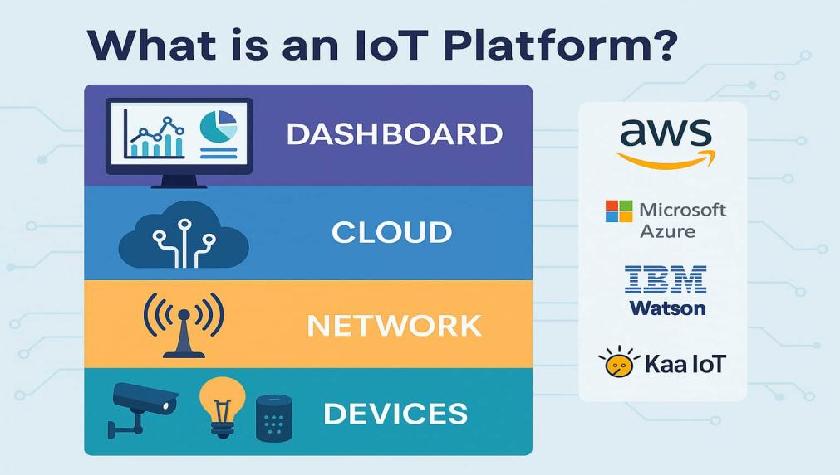
IoT Indexing

Slide 2
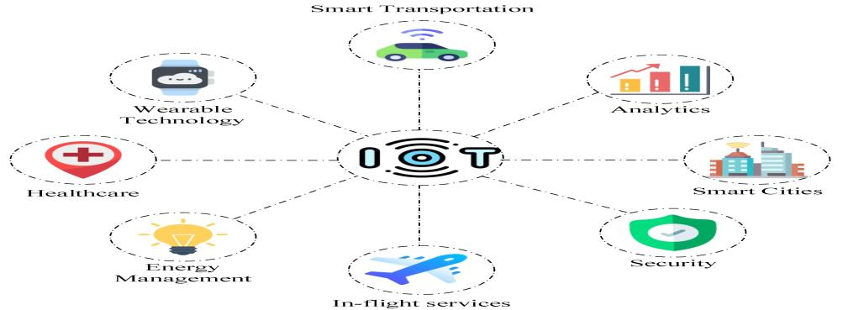
Introduction
A generic IoT platform must handle data from various device types and scenarios that may evolve over time. Efficient data retrieval requires a robust indexing mechanism to quickly access records by device or location. This presentation explores how indexing supports this need and why a JSON-based document database like MongoDB is well suited for flexible IoT data storage.

Slide 3
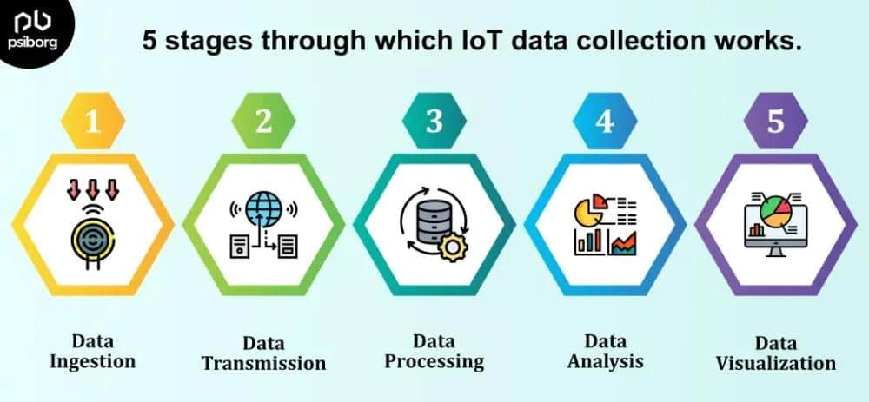
IoT Device Data Management

Slide 4

Challenges in supporting diverse devices
IoT platforms face complexity from many device types generating heterogeneous data. Designs must anticipate unknown future devices and support their data formats without complete redesign. This requires adaptable structures to capture varied device and sensor data reliably across multiple contexts.

Slide 5
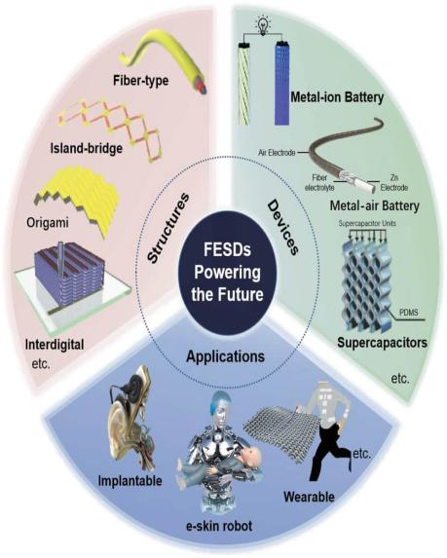
Importance of flexible data storage
A rigid schema limits scalability and responsiveness in evolving IoT environments. Flexible, schema-less storage enables seamless integration of new device data types. It supports heterogeneous record structures, allowing for dynamic indexing and efficient querying of common parameters like temperature across device categories.

Slide 6
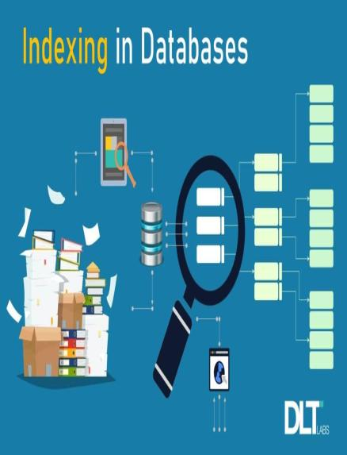
Role of indexing in efficient data retrieval
Indexing is essential for rapidly accessing IoT data, enabling queries by multiple attributes such as device ID and location ID. It supports efficient retrieval of records for specific devices, even across different locations. This flexible indexing ensures quick access to common parameters like temperature, improving overall system responsiveness and data usability.

Slide 7
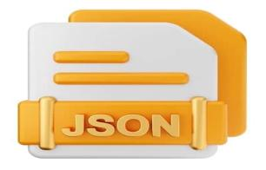
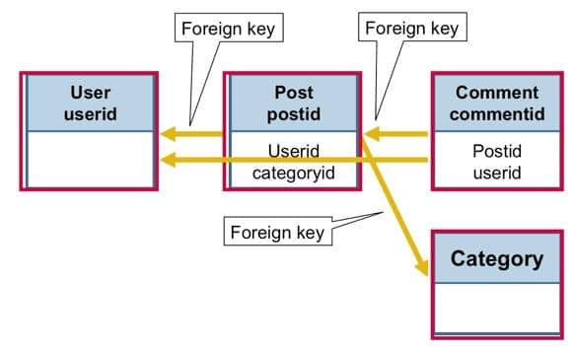
JSON-Based Document Databases in IoT
A JSON-based document database is a type of NoSQL database management system (DBMS) that stores and retrieves data in the form of JSON (JavaScript Object Notation) documents. Unlike traditional relational databases that use a rigid, tabular structure with predefined schemas, document databases offer a more flexible, schema-less approach.

Slide 8

Advantages of MongoDB for IoT platforms
MongoDB offers a flexible, schema-less data model that accommodates diverse IoT device data types. Its document-oriented structure supports nested and varied data, enabling easy adaptation to unknown or evolving devices. Additionally, MongoDB provides powerful indexing capabilities and scalability, making it ideal for complex IoT data management.

Slide 9
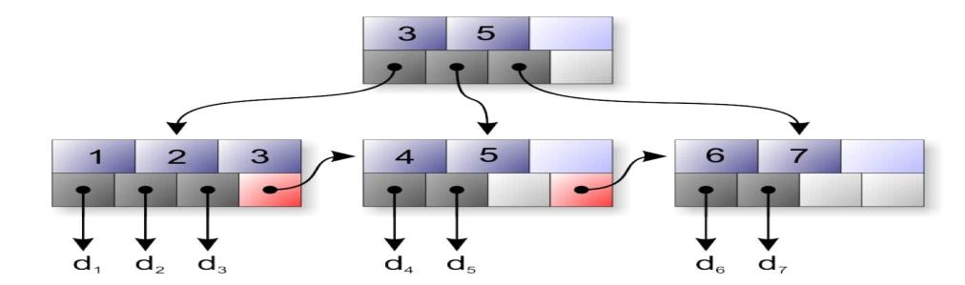
Indexing strategies in MongoDB for devices and locations
MongoDB supports compound indexes combining device ID and location ID, facilitating precise queries for device data across different locations. Indexes on common parameters enable fast aggregation and retrieval. These strategies enhance query performance by reducing search scope and enabling multi-dimensional access to IoT datasets efficiently.

Slide 10

Sample JSON schema for multi-device data storage
A typical JSON document may include deviceId, locationId, timestamp, and sensor readings such as temperature. MongoDB’s flexible schema allows adding new fields without impacting existing ones, accommodating different device data structures seamlessly and supporting versatile query patterns across multiple parameters.

Slide 11

Conclusions
Efficient indexing and flexible data storage are critical for managing diverse IoT device data. MongoDB’s JSON-based document model provides the adaptability and performance needed for evolving IoT platforms. Proper indexing strategies ensure quick, reliable access to device and location data, enabling effective analysis and decision-making in complex IoT environments.

Slide 12

Thank you

